Slide 1
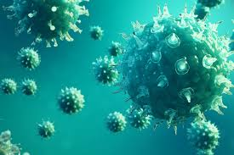
Viruses
Presented by:
Dr. Ankit Kumar Singh
Assistant Professor
Department of Botany
Marwari College
Lalit Narayan Mithila University
Darbhanga
ankitbhu30@gmail.com

Slide 2
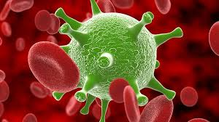
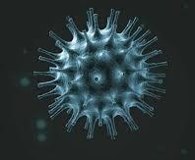
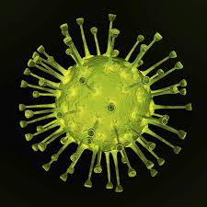
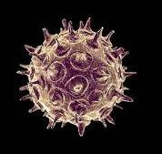
Martinus Willem Beijerinck (1897) coined the Latin name “virus” meaning poison. They are too small to be seen by light microscopy, and are able to multiply only within the living cells of a host.
Viruses (infective agents) are simple, noncellular entities consisting of genetic material (one or more molecules of DNA or RNA) enclosed in a protein coat (capsid). Wendell Stanley (1935) discovered they are made of nucleic acid and protein.
A fully assembled infectious virus is called virion. The main function of the virion is to deliver its DNA or RNA genome into the host cell so that genome can be transcribed and translated by the host cell.
Each viral species has very limited host range i.e. It can reproduce in only a small group of locally related species. They are spread by many ways i.e. through air , by different vectors or by exposure to infected bodily fluids .

Slide 3
Viruses discovery
In 1884 C. Chamber Land, in Pasteur’s lab, discovered that if you passed a liquid containing bacteria through an unglazed PORCELAIN tube, the bacteria were completely retained and the solution that passed through (the filtrate) was sterile.
In 1892, D. Iwanowski applied this test to a filtrate of plants suffering from tobacco mosaic disease with shocking results; the filtrate was fully capable of producing the original disease in new hosts.

Slide 4
General characteristics of viruses
They are obligate intracellular parasites of bacteria, protozoa, fungi, algae, plants and animals.
They are smaller than bacteria, and range in size between 20-300 nm.
They contain only one type of nucleic acid (genetic material) either DNA or RNA, but never both.
Nucleic acid can be double-stranded DNA, single-stranded DNA, double-stranded RNA, or single-stranded RNA
They vary in shape from the simple helical and icosahedral to more complex structures.
They lack cellular organelles such as mitochondria, ribosomes etc.
They multiply by taking control of host cell’s genetic material and regulating the synthesis and assembly of new viruses.

Slide 5
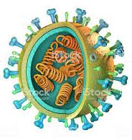
Generalized structure
Envelope
Capsid
Nucleic acid
Spikes

Slide 6
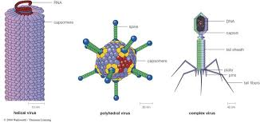
Shape/ symmetry
Helical symmetry
Icosahedral symmetry
Complex symmetry

Slide 7
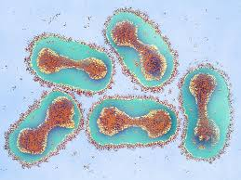
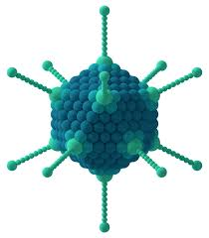
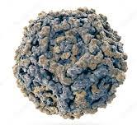
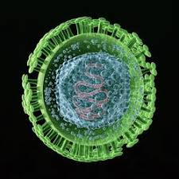
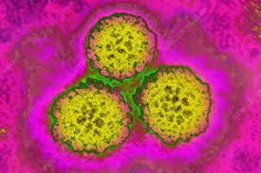
DNA Viruses
Enveloped
Nonenveloped
Double-stranded genome
Double-stranded genome
Single-stranded genome
Poxviruses
Adenoviruses
(linear ds DNA)
Parvoviruses
Herpesviruses
Papovaviruses
(circular ds DNA)

Slide 8
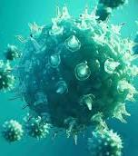
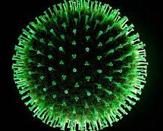
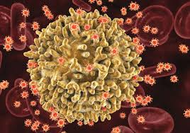
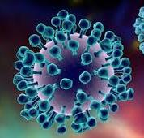
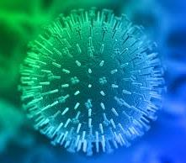
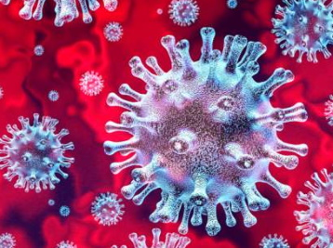
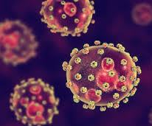
RNA Viruses
Enveloped
Nonenveloped
Single-stranded
genome
Single-stranded
Genome encodes
reverse transcriptase
Single-stranded
genome
Double-stranded
genome
Picornaviruses
Reoviruses
Sigmented
genome
Nonsigmented
genome
Retroviruses
Orthomyxoviruses
Paramyxoviruses
Ebolaviruses
Caliciviruses
Coronaviruses
Arenaviruses

Slide 9
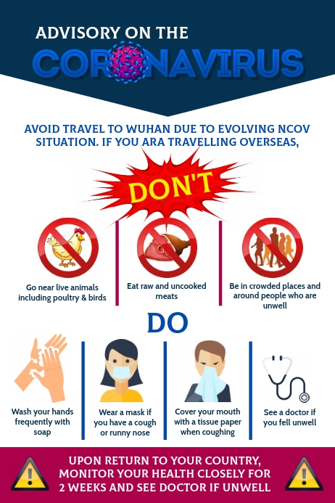
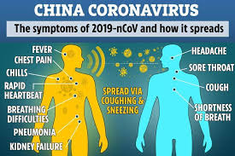
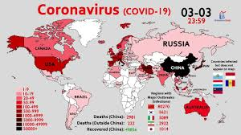
COVID- 19

Slide 10
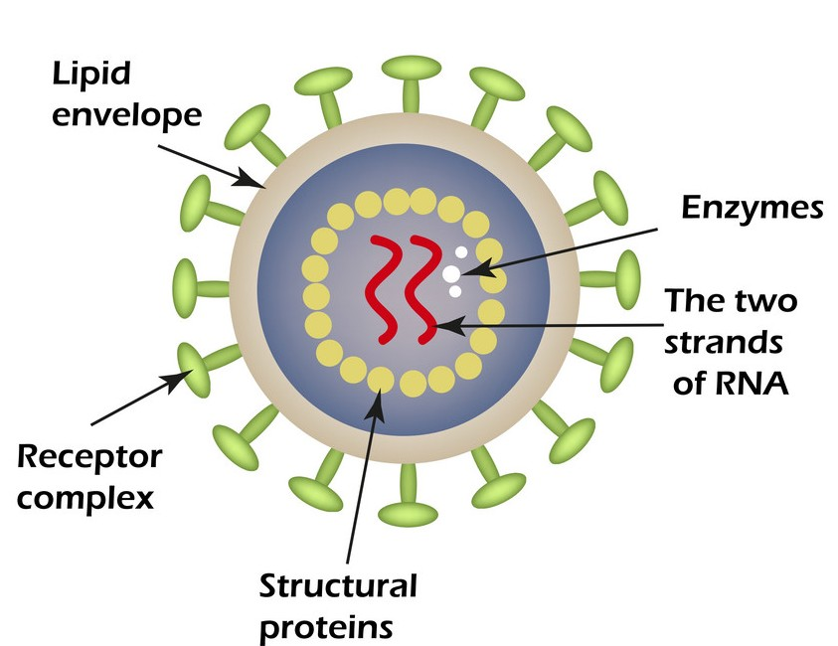
Retroviruses
They are ssRNA containing enveloped animal viruses that replicate through a DNA intermediates.
There are two copies of linear, identical ssRNA molecules.
The retroviral life cycle proceeds by reverse transcribing the RNA genome into ds DNA, which is inserted into the host genome.
The Acquired Immuno Deficiency Syndrome (AIDS) was first recognized in the United States in 1981 in the Los Angeles, New York, and San Francisco.
Etiologic agent of AIDS is Human Immunodeficiency Virus (HIV) which was discovered and characterized by Luc Montagnier and Robert Gallo in 1983.
Human Immunodeficiency Virus (HIV)

Slide 11
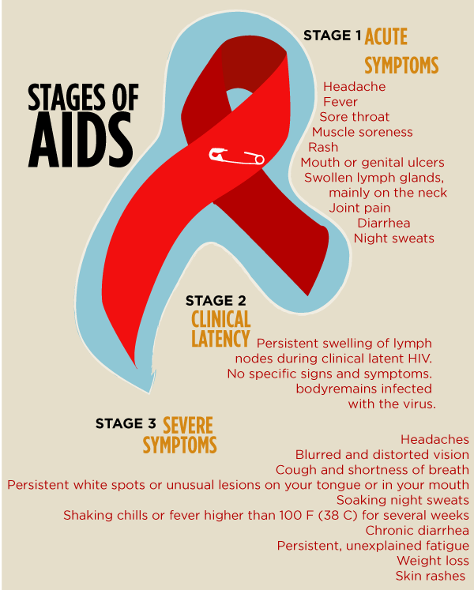
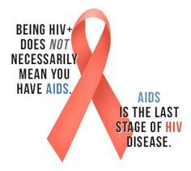
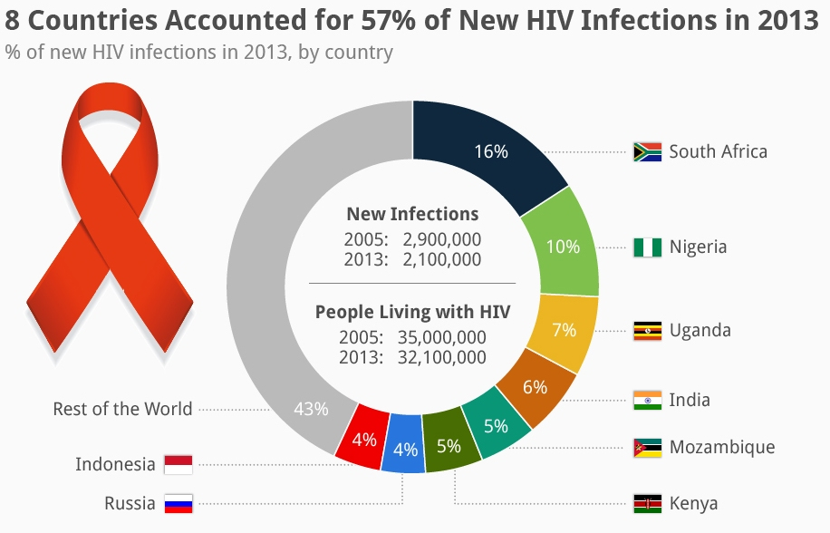

Slide 12
Bacteriophage

Slide 13
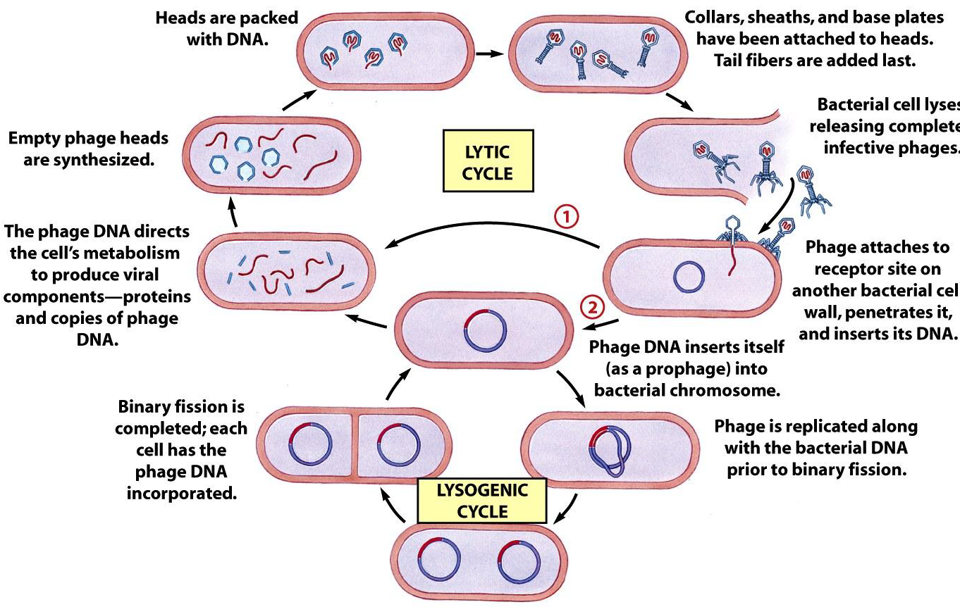

Slide 14
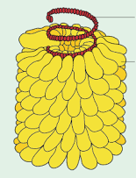
Plant viruses
Plant viruses exist in rod and polyhedral shape.
Most plant viruses have genomes consisting of a single RNA strand.
The best known plant virus is the rod-shaped tobacco mosaic virus (TMV).
There are only two classes of DNA containing plant viruses:
The cauliflower mosaic virus (ds DNA genome, polyhedral capsule)
The geminiviruses (gemini= twins) containing circular ss DNA
TMV has a rod like appearance.
It’s capsid is made up of about 2130 capsomeres.
One molecule of genomic ss RNA present in centre of the capsid.
The capsomeres are self-assembles into the rod like helical structure around the RNA.
RNA
Capsid
Tobacco Mosaic Virus (TMV)

Slide 15
Prions and Viroid
Prions are proteins.
The word prion, coined in 1982 by Stanley B. Prusiner, is derived from the words proteins and infection.
The infections by prions are responsible for neurodegenerative diseases in animals including human.
Prion diseases are described as spongiform encephalopathies.
No prion diseases of plants are known.
Kuru was the first naturally occurring spongiform encephalopathy of humans shown to be caused by prions.
Viroids are the smallest infectious agents of plants that are single stranded, covalently closed circular RNA molecule not associated with any protein.
It was discovered and named by Otto Diener.
Viroids have so far been shown to infect plants only.
No viroid diseases of animals are known.

Slide 16
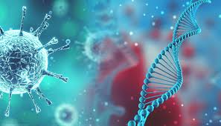
Thank You !!

